Slide 1

Pitch Smurf
Andrew Mo
Aditya Singhal

Slide 2
Architecture
Built with Python and Native WebStack
The Flask backend serves the main connection point where the user inputs the company name
Company is converted to a ticker symbol using Marketdata API
Ticker symbol is used to access financial and other information about the company
We provide distinctive price analysis values based on TTM data
All of this data is presented as a PowerPoint.
Demo: http://127.0.0.1:5000/

Slide 3
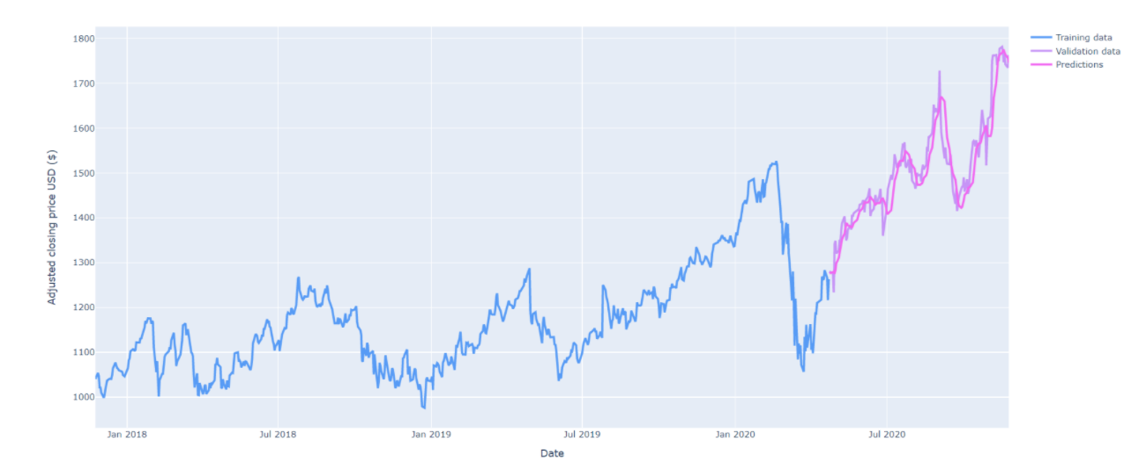
Stock Prediction and Modeling
Long short-term memory Model
Recurrent AI Neural Network (deep learning) with feedback connections so it can process entire sequences of data vs traditional 1 point.
Transformer Model
The LSTM model is used to train the Transformer model (deep learning recurrent neural network). This model is designed to handle sequential data including layering so we can correlate sequential data of different types.
Pandas (Python Library) Datareader
Used to gather all historic data to train the model
This approach allows us to keep historic P/E and P/B value while training the model
Sample output of completed model trained on TTM data for GOOG (Alphabet Inc.)

Slide 4

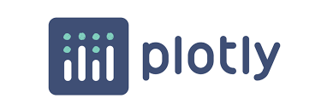



Front End
Backend +
Financial Model
Provider

